Slide 1
User Stories
Gastón Landeira - 238473
Matías González - 219329
Iñaki Etchegaray - 241072

Slide 2
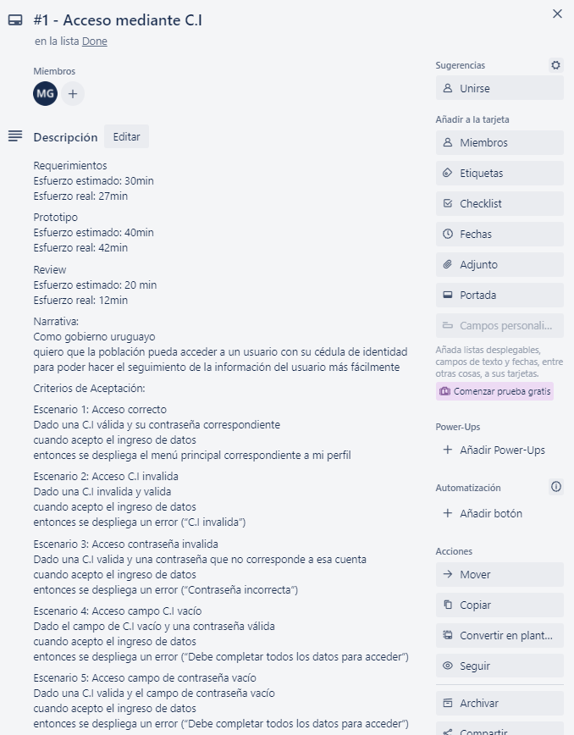
UserStories

Slide 3
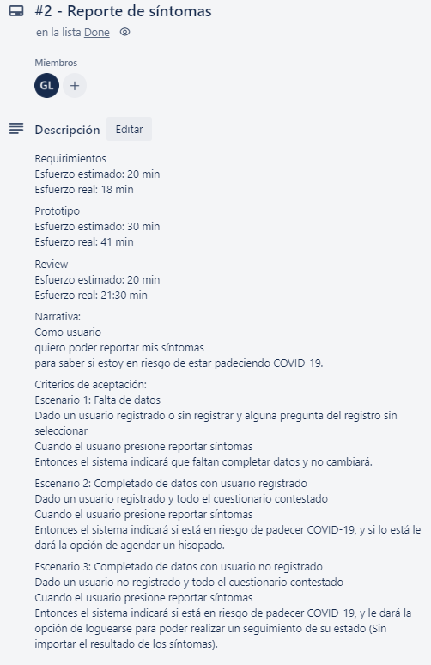
UserStories

Slide 4
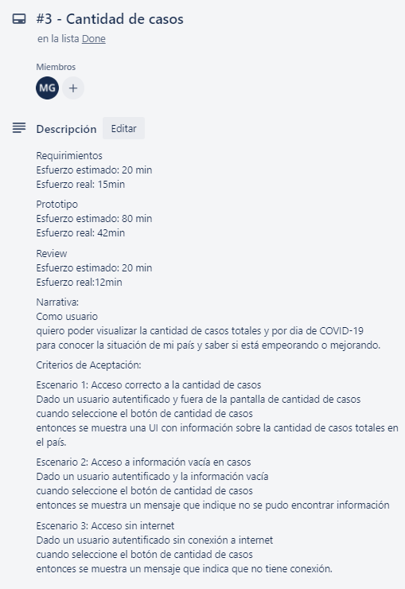
UserStories

Slide 5
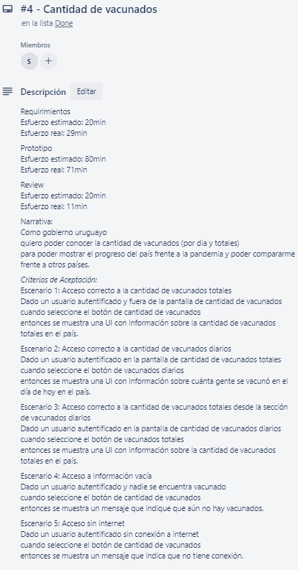
UserStories

Slide 6
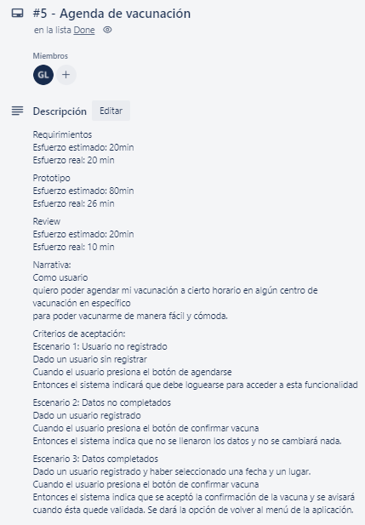
UserStories

Slide 7
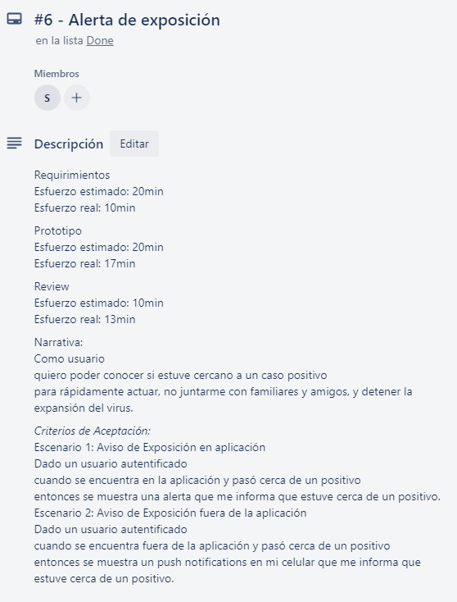
UserStories

